Slide 1

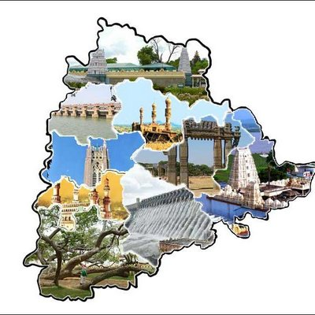
aoj Telangana state
February 2024 report

Slide 2

February month promise

Slide 3

Telangana state

Slide 4
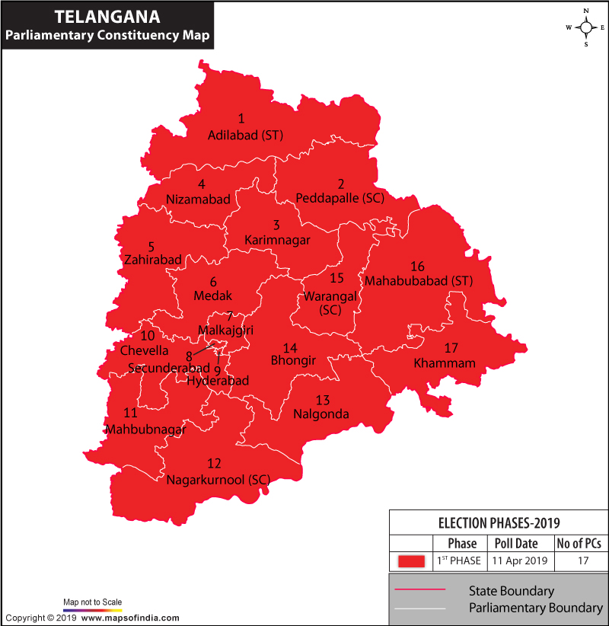
Telangana –mp constituency map

Slide 5
Telangana – smp -17
MICAH ZONE – WARANGAL ZONE
MALACHI ZONE – HYDERABAD ZONE
Adilabad – Sol Sunil Babu
Bhongir – Sol Swapna
Karim Nagar – Sol Uma Rani
Mahabubabad – Sol Rani
Medak – Sol Lavanya
Nalagonda – Sol Nirmala
Peddapally – Sol Vijayakumar
Warangal – Sol Jyothi
Hyderabad - Sol Saritha
Secunderabad – Sol Shiny Rebecca
Cheyvella - Sol Suresh
Nagarkurnool - Sol Pavani
Malkjagiri – Sol Shiny
Mehaboobnagar – Sol Rajamani
Khammam – Sol Vaani
Nizamabad – Sol Narasingh Rao
Zahirabad – Sol Inna Reddy

Slide 6

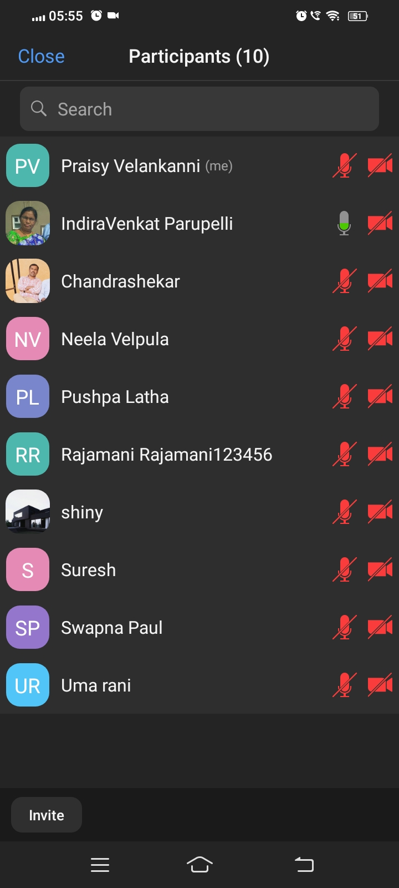
common morning worship
Praise & Worship , Devotion Time and Intercessory prayer strengthens everyone of the group.
This month the Lord is adding new members and strengthening the existing group members.
The Lord God have answered the prayers of the soldiers during intercessory prayer
Visions and revelations received during prayer. Thanks be to the Lord.

Slide 7
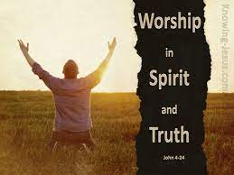
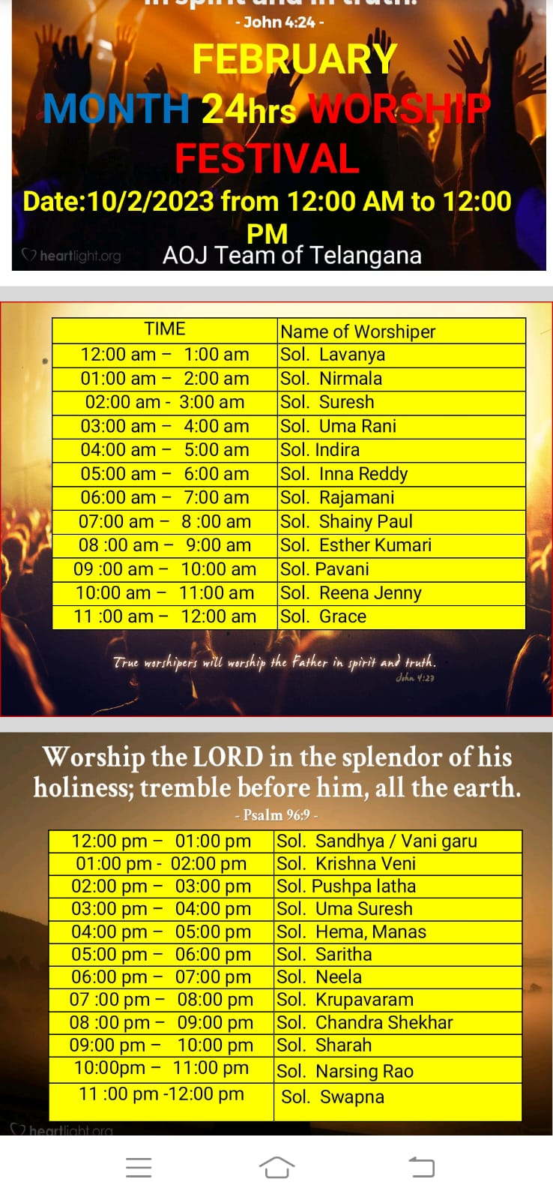
24/7 hrs februRY MONTH WORSHIP FESTIVAL
Praise & Worship this month also God raised Soldiers to be alert in spirit to do worship 24 hrs without fail.
We also pray that 24 hrs constituency wise worship soldiers be raised for the glory of the Lord.

Slide 8
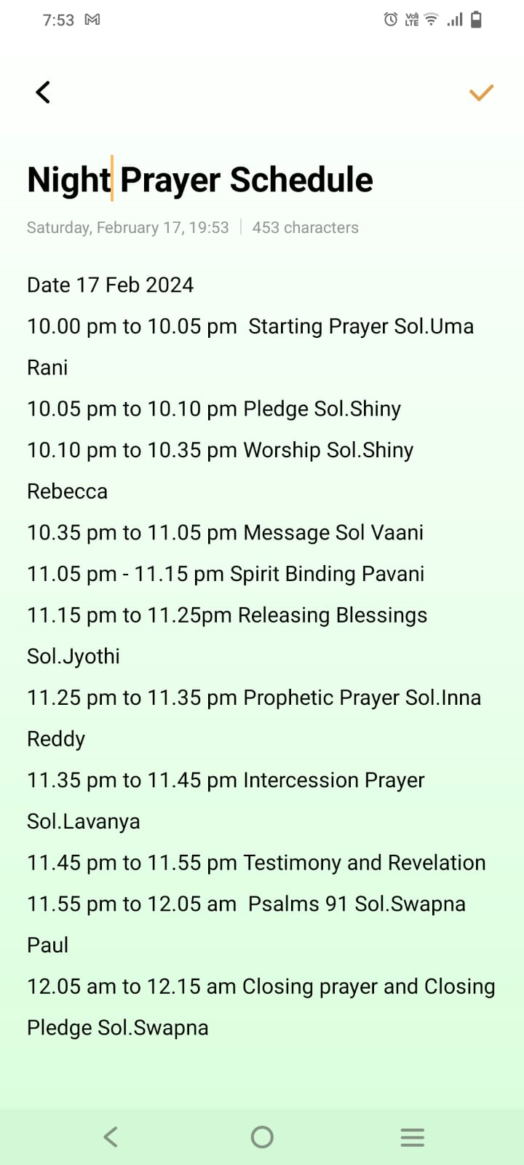
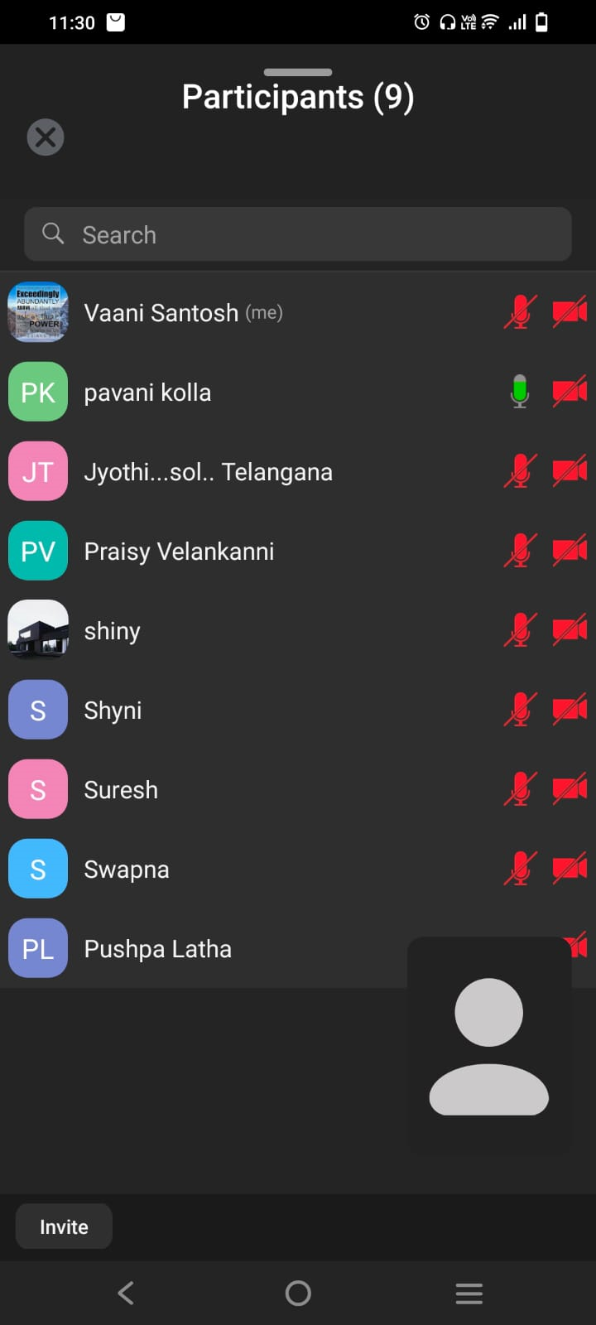
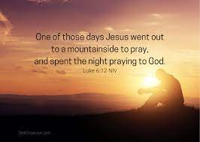
night prayer
Night prayer was held on February 17th Saturday between 10 pm to 12 .15 am thru zoom
Around 9 members attended this prayer.
We presented many constituency issues to be solved before the Lord in prayer.
After this night prayer we see that the Lord strengthening the team and adding new members to the team
Glory to God.

Slide 9
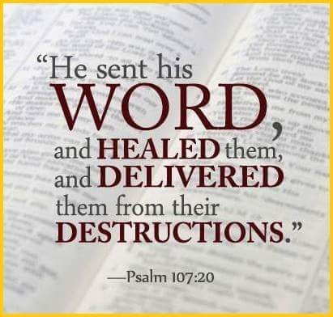
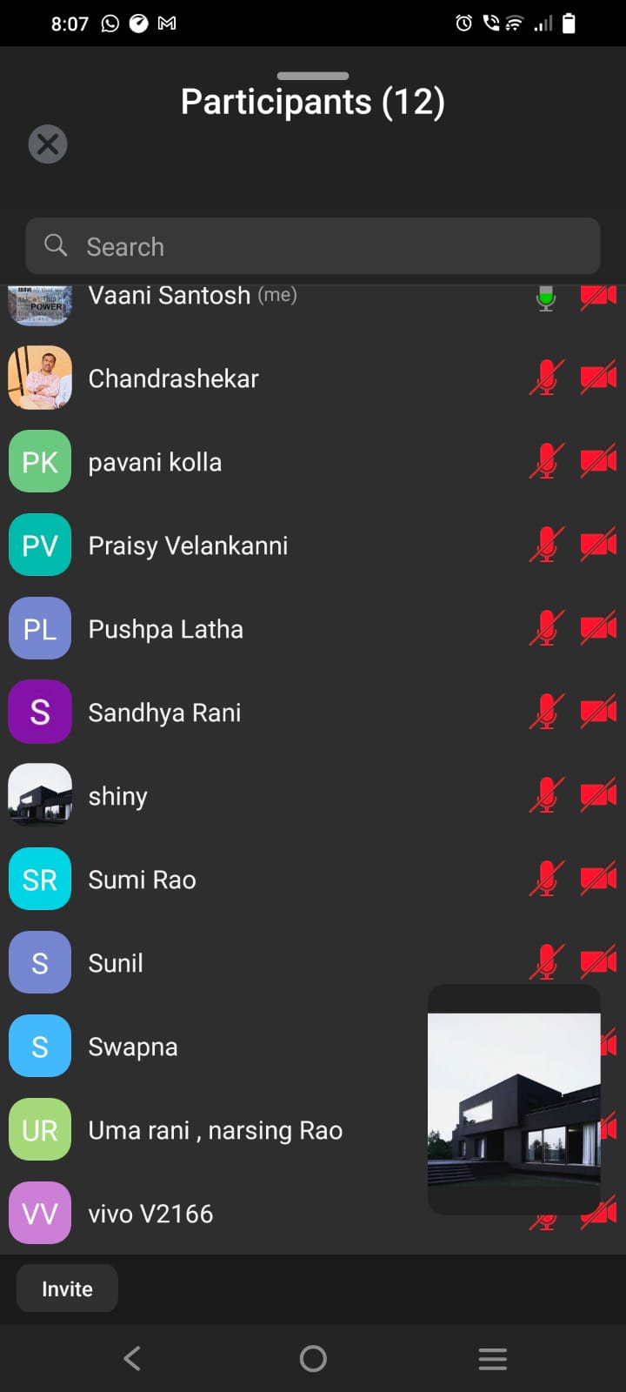
Bethesda school of healing – LEVEL 1
This Healing School was registered in the Gift school website. School began on 12 Feb 2024 to 22 Feb 2024
Around 12 members attended this School.
Everyone experienced Gods intervention in this School.
Many received Healing and new participants attended this school.
Sol Inna Reddy , Sol Lavanya , Sol Rani sastry , Sol Sunil Babu and Sol Vaani Santhosh were the teachers.
4 New Teachers raised in this School.

Slide 10
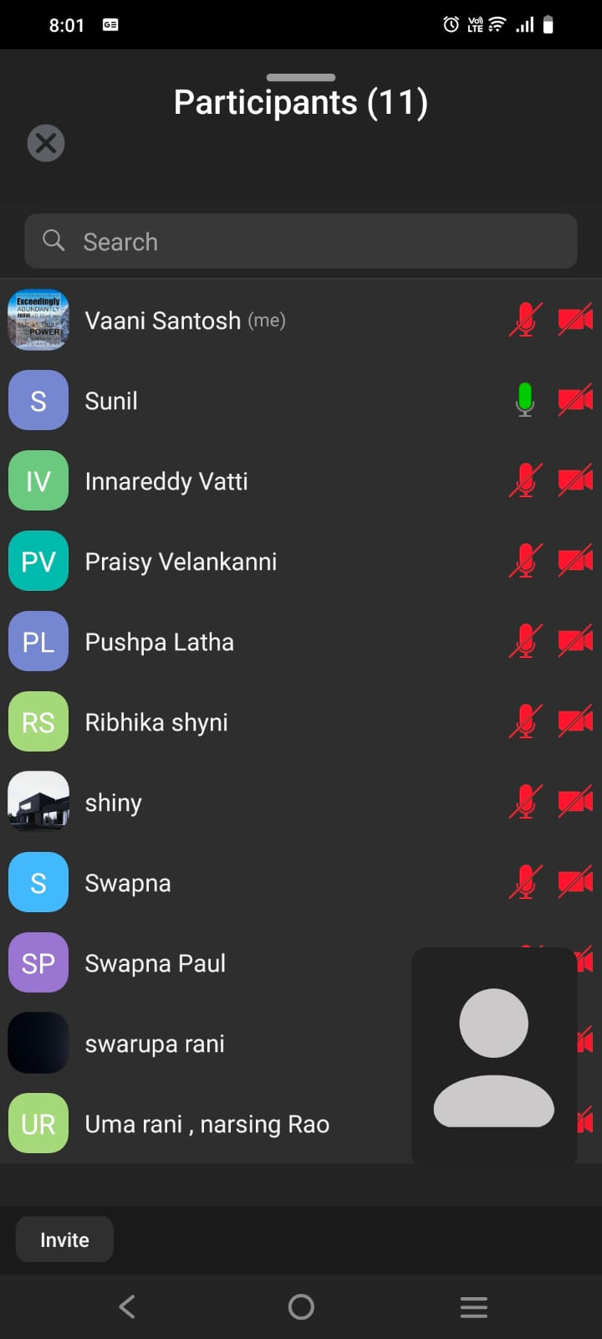
shadow parli meeting
Shadow Parli was conducted on Feb 25,2024 evening 7 pm to 9pm
Around 12 Smps out of 17 smps attended this meeting.
Message them was about the Lord God is mustering His army for Battle (Isaiah 14:3).
Heavenly Court Appeal topic is stopping the manifestation of evil spirits in Samakka Sarakka Jatara.
Many received Visions and revelation during the appeal.
Especially Opero Program was seen in vision while we were bringing the petition in the name of Jesus Christ.

Slide 11
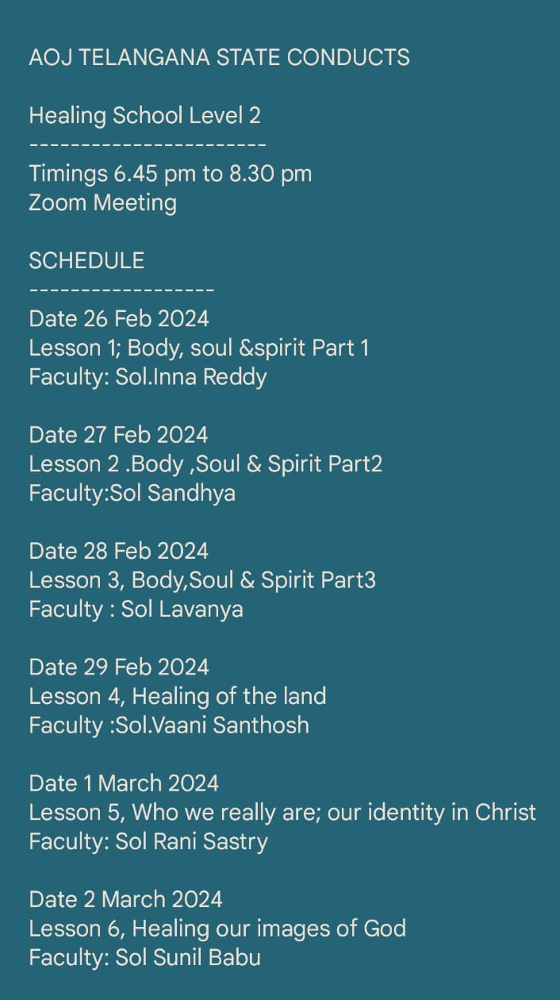
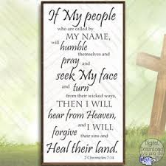
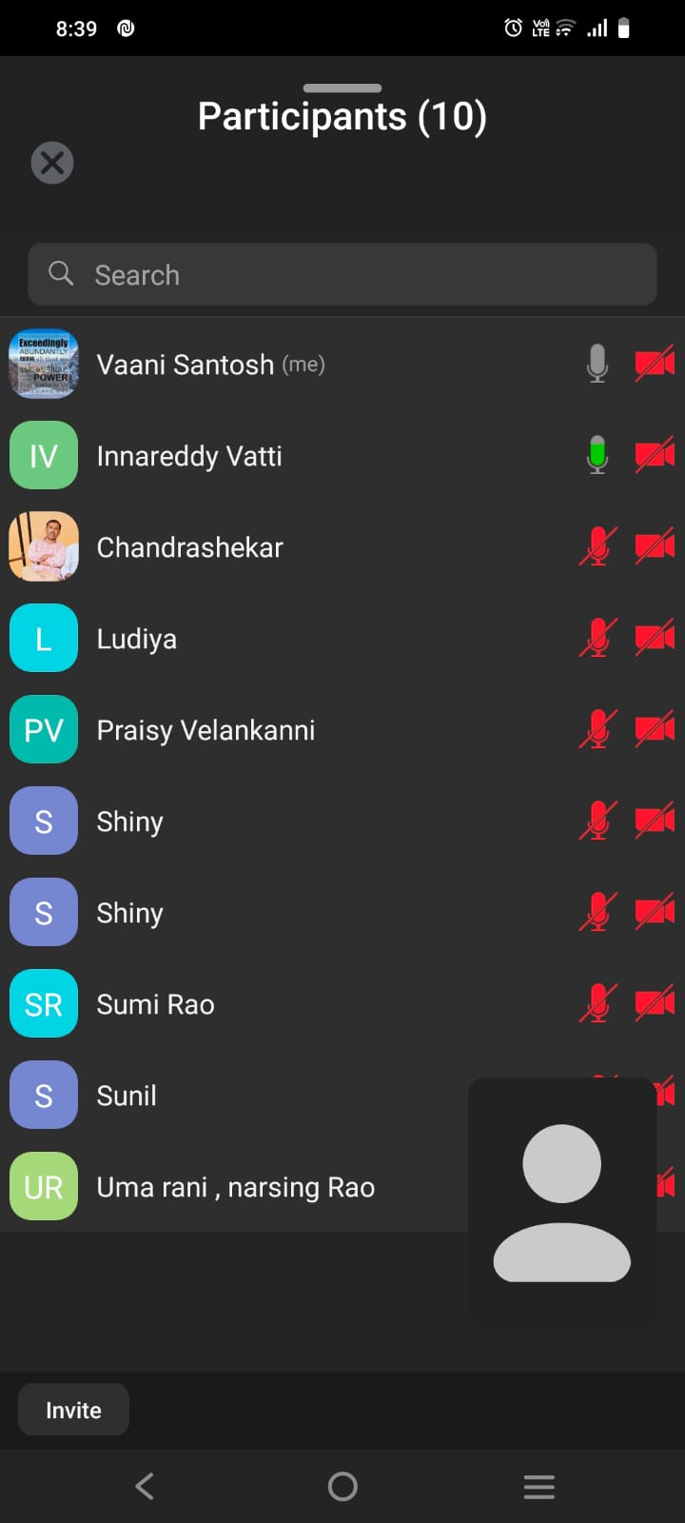
BETHESDA SCHOOL OF HEALING – LEVEL 2

Slide 12
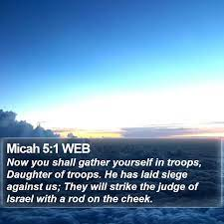
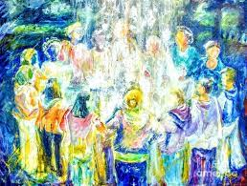
TROOP MEETNG
The Holy Spirit gave a name for the Troop Triumphant Entry of Canaan .
This Troop will be started this Thursday Feb 29, 2024.
March month we want start troop among zones.

Slide 13
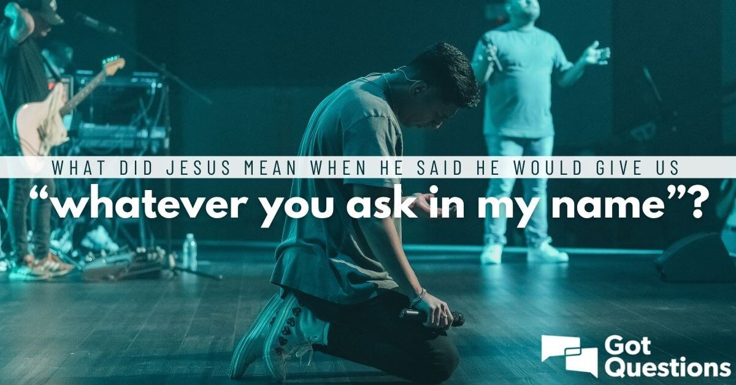

testimony

Slide 14
Common morning worship testimony
Sol Sareetha daughter consumed Sanitizer out of depression and she was hospitalized ,but the Lord healed and delievered her from the harm.Glory to God.
Sol Nirmala mother was undergone uterus removal prayer she was bedridden for many days, but the Lord heard the prayer and healed her completely recovered.
Sol Pavani Son Hemanth received 10/10 in 10th standard He was placed topper in School. His photo was printed in the School flex in the top first place.
Sol Suresh got better job with god salary than the old.
Sol Swapna got Government job and her Father under went 2 successful eye surgery.
Sol Santhosh received a part of His outstanding money.
Sol Varun Tej Son of Sol Swapna Paul got recovered from mental illness and got a job. The Lord God restored the Peace at Home.
Sol Prasanna had a issue in her pregnancy and the Lord healed the baby and gave good delivery and good health for both baby and mother.Praise the Lord.
The Lord Blessed Sol Sunil to buy a new house.
Sol Lavanya asked for School transfer in better location, The Lord God answered her prayer and Healed her from Head Ache and Answered prayer regarding School issues.

Slide 15
planning of march 2024
bff
Troop church zone wise
fellowship meeting in different constituency
24/7 chain prayer and fasting prayer
constituency wise 24/7 worship
healing 2nd and 3rd level
shadow parli
zonal meeting

Slide 16
viable changes seen in Telangana government
THE CURRENT CHIEF MINISTER IS REVANTH REDDY OF THE INDIAN NATIONAL CONGRESS SINCE 7 DECEMBER 2023.
Telangana govt decides to implement ₹500 a cylinder and 200 units free power tentatively from Feb 27 or 29
The Mahalakshmi scheme, which offers women and transgender persons free travel on state-run non-AC buses, has breathed fresh life into an ailing Telangana State Road Transport Corporation (TSRTC), as numbers show an increased occupancy in buses, resulting in a considerable rise in daily revenue.

Slide 17
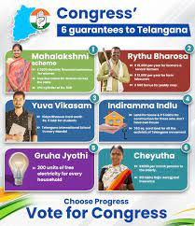
guarantee of current government
LET US PRAY THAT EVERY SERVICES REACHES ALL PEOPLE OF 17 CONSTITUENCY OF OUR STATE IN JESUS NAME.

Slide 18
Caste Census Report 2024
According to the promise made by the Congress Party in the recent assembly elections in Telangana state, now after the formation of the Congress government, Caste Census Telangana 2024 has been started, through which caste census will be started in the state so that the economic condition of the state can be assessed. The number of backward-class citizens will be determined. Through the Caste Census Report 2024 launched in Telangana state, the state government will establish schools and educational centers for the students of SC ST or BC category.

Slide 19
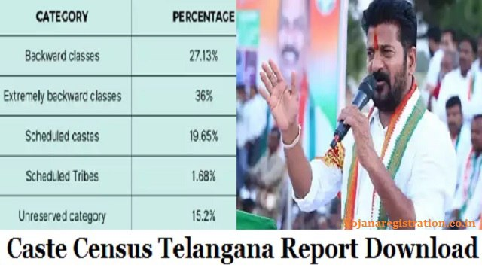
Caste Census Report 2024
LET US PRAY EVERY CATEGORY PEOPLE BE RECOGNISED AND RECEIVE PROPER EMPLOYMENT AND PROPER SALARY AND PROPER EDUCATION IN JESUS NAME.

Slide 20

Dear Lord Jesus Christ let your PERFECT will be done on our state. Send us your resurrection power and revive us O Lord!
THANK YOU LORD FOR EVERYTHING YOU HAVE GIVEN US!!!!!!!

