Slide 1
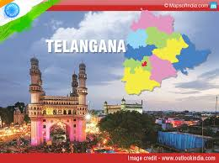
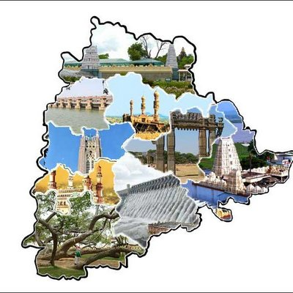
aoj Telangana state
April 2024 REPORT

Slide 2
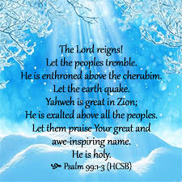

APRIL month promise

Slide 3
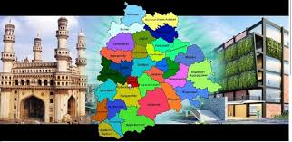

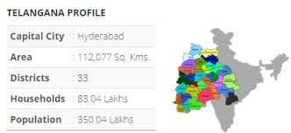
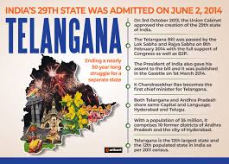
Telangana state

Slide 4
Telangana – 17 constituencies
MICAH ZONE – WARANGAL ZONE
MALACHI ZONE – HYDERABAD ZONE
Adilabad – Sol Sunil Babu
Bhongir – Sol Swapna
Karim Nagar – Sol Uma Rani
Mahabubabad – Sol Rani
Medak – Sol Lavanya
Nalagonda – Sol Nirmala
Peddapally – Sol Vijayakumar
Warangal – Sol Jyothi
Hyderabad - Sol Saritha
Secunderabad – Sol Shiny Rebecca
Cheyvella - Sol Suresh
Nagarkurnool - Sol Pavani
Malkjagiri – Sol Shiny
Mehaboobnagar – Sol Rajamani
Khammam – Sol Paul Hudson
Nizamabad – Sol Narasingh Rao
Zahirabad – Sol Inna Reddy

Slide 5

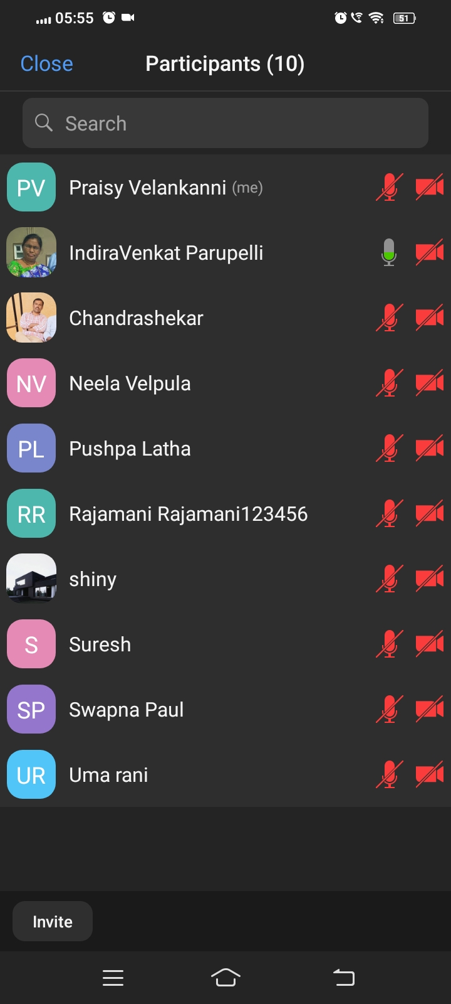
common morning worship
Praise & Worship , Devotion Time and Intercessory prayer strengthens everyone of the group.
This month the Lord is adding new members and strengthening the existing group members.
The Lord God have answered the prayers of the soldiers during intercessory prayer
Visions and revelations received during prayer. Thanks be to the Lord.

Slide 6
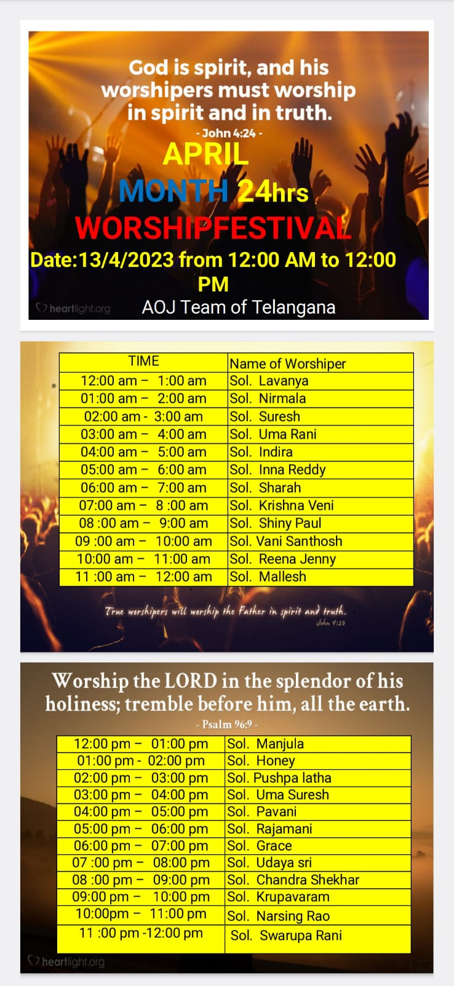
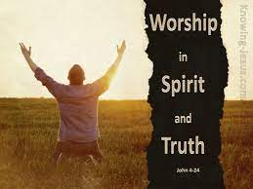
24/7 hrs APRIL MONTH WORSHIP FESTIVAL
Praise & Worship this month also God raised Soldiers to be alert in spirit to do worship 24 hrs without fail.
We also pray that 24 hrs constituency wise worship soldiers be raised for the glory of the Lord.

Slide 7
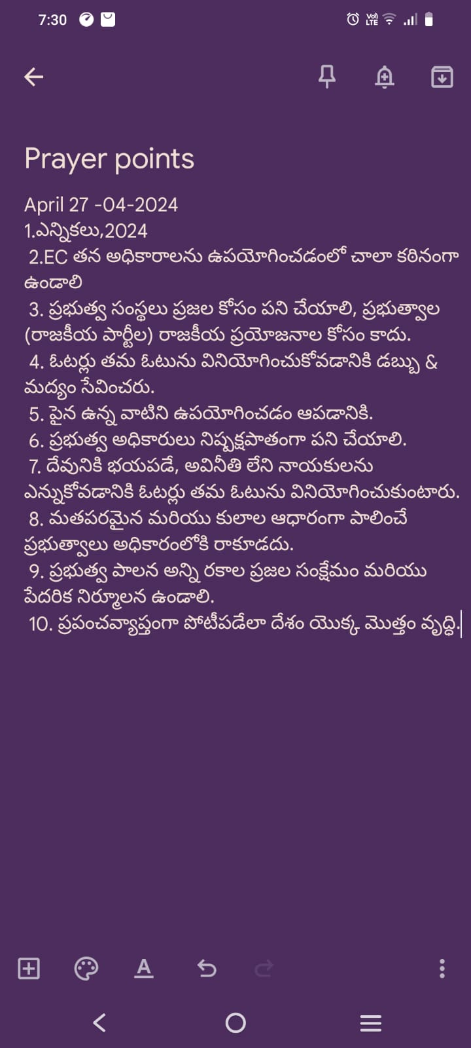
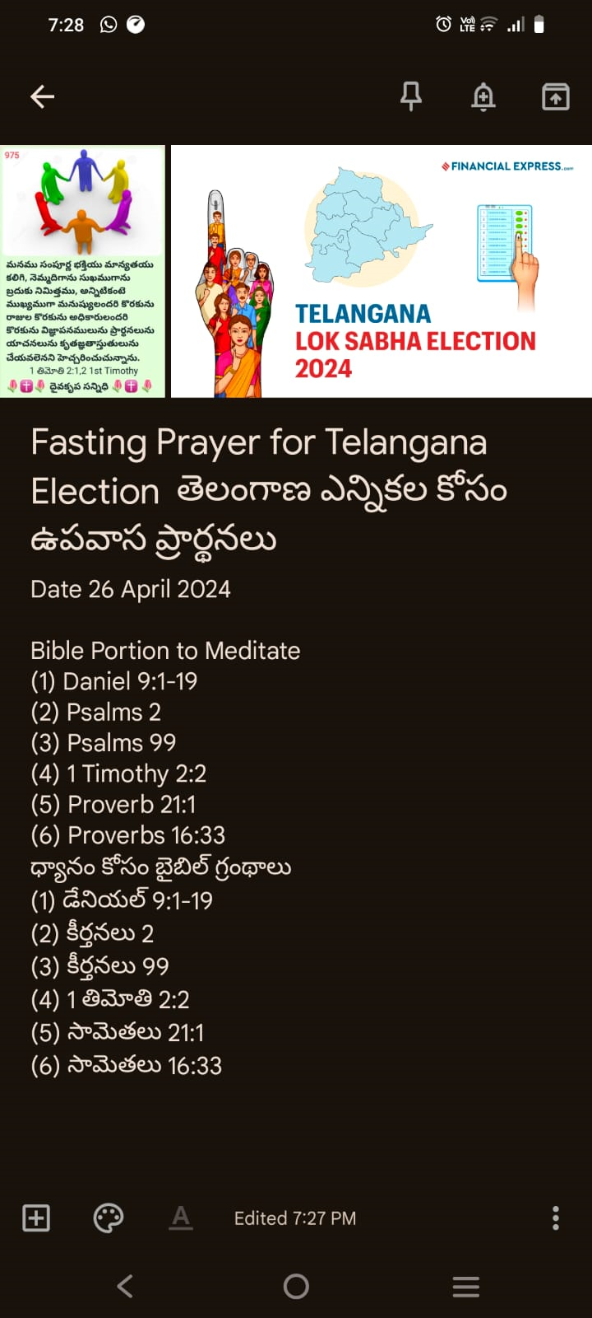
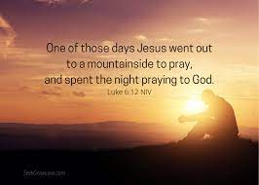
FASTING PRAYER ON BEHALF OF UPCOMING ELECTION 2024

Slide 8
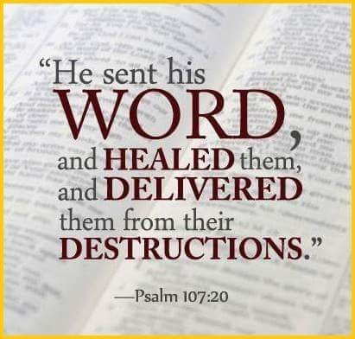
FORGIVENESS AND RECONCILATION PROGRAM
FRP program was organized by Sol Paul Hudson from Chennai at Palvancha ,Telangana District near Bhadrachalam on April 9th and April 10th .
Sis Angelica and Mother Leema Rose were main Teachers of the program.
Sol Inna Reddy and Sol Sunil Babu played a role of Translator and Teacher in this program for the glory of the Lord.
This program was conducted among many Banjar community Pastors.
Around 40 to 50 participants of this program.

Slide 9
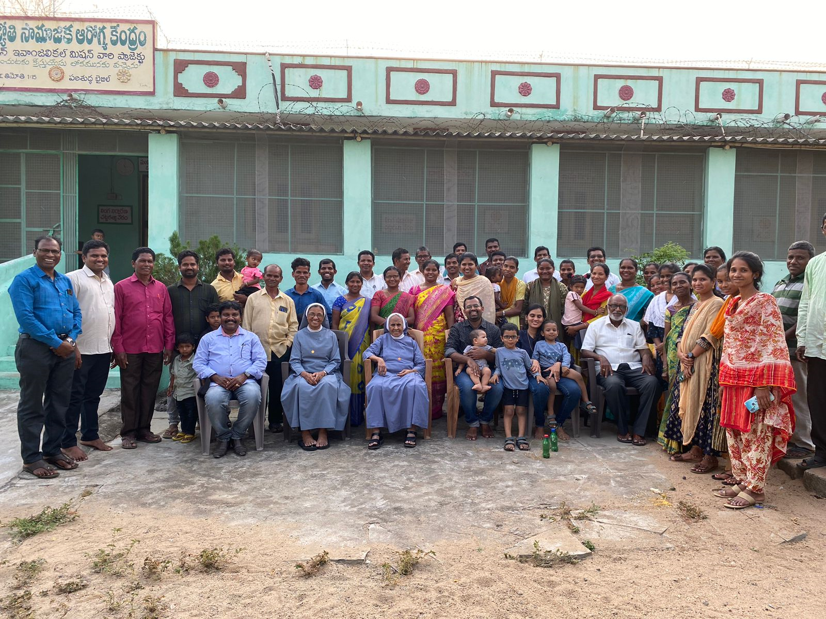
frp ,palavancha

Slide 10
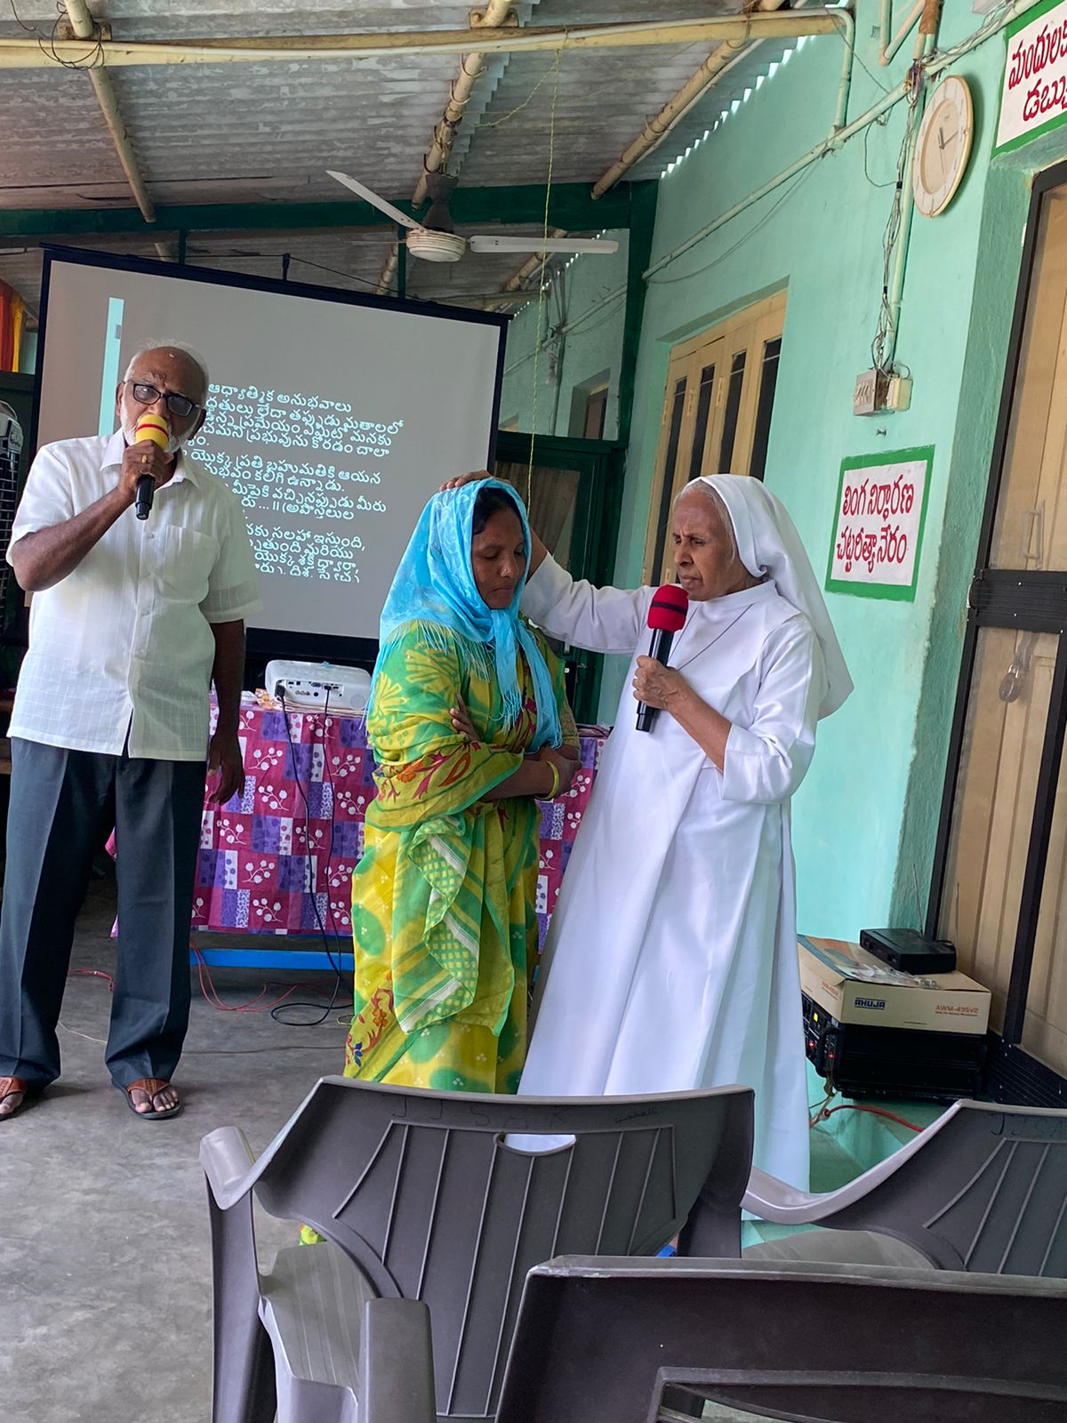
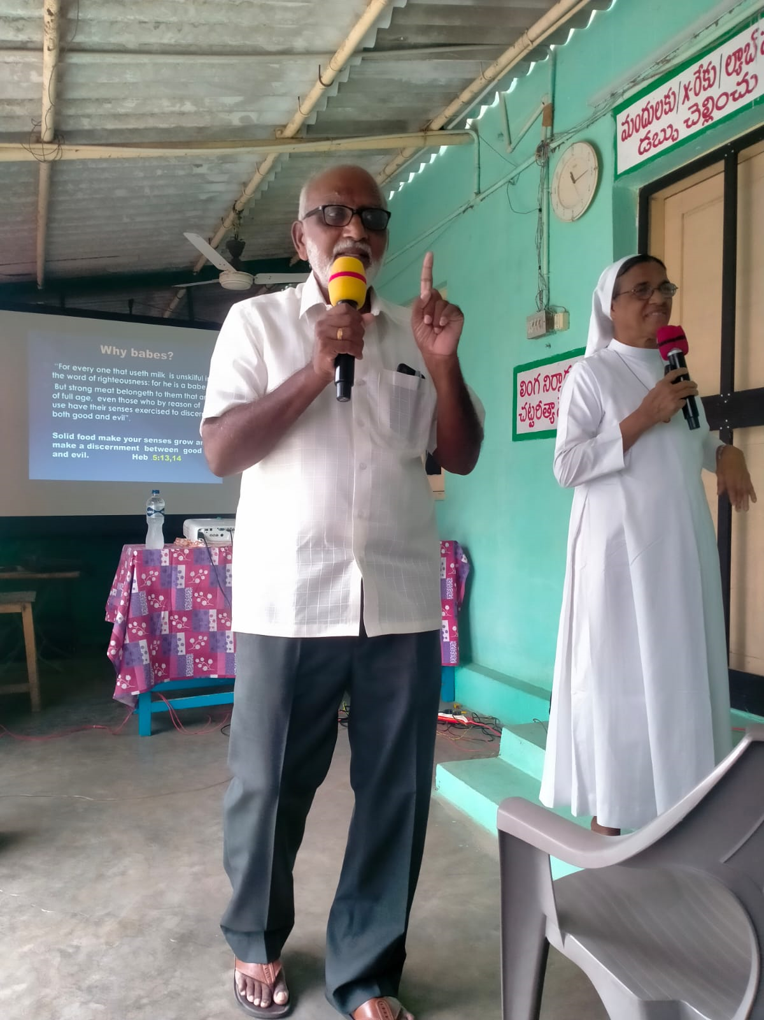

Slide 11
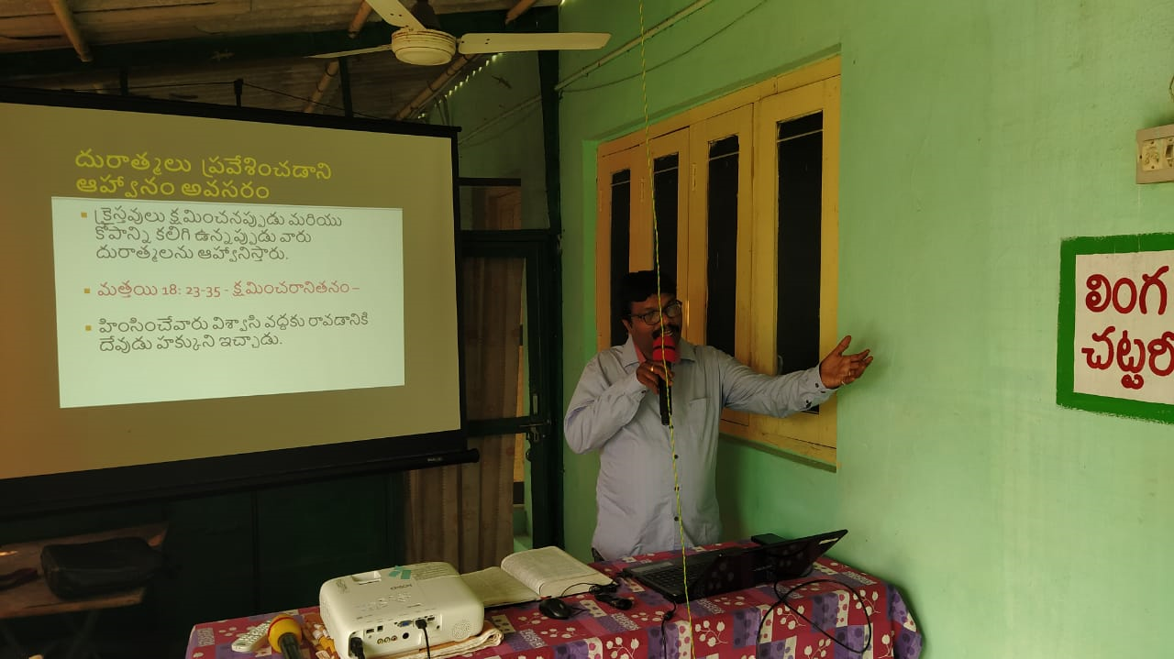
frp 2nd day, palvancha

Slide 12

Soldier ludiya, mother of sol shiny Rebecca went to be with the lord

Slide 13
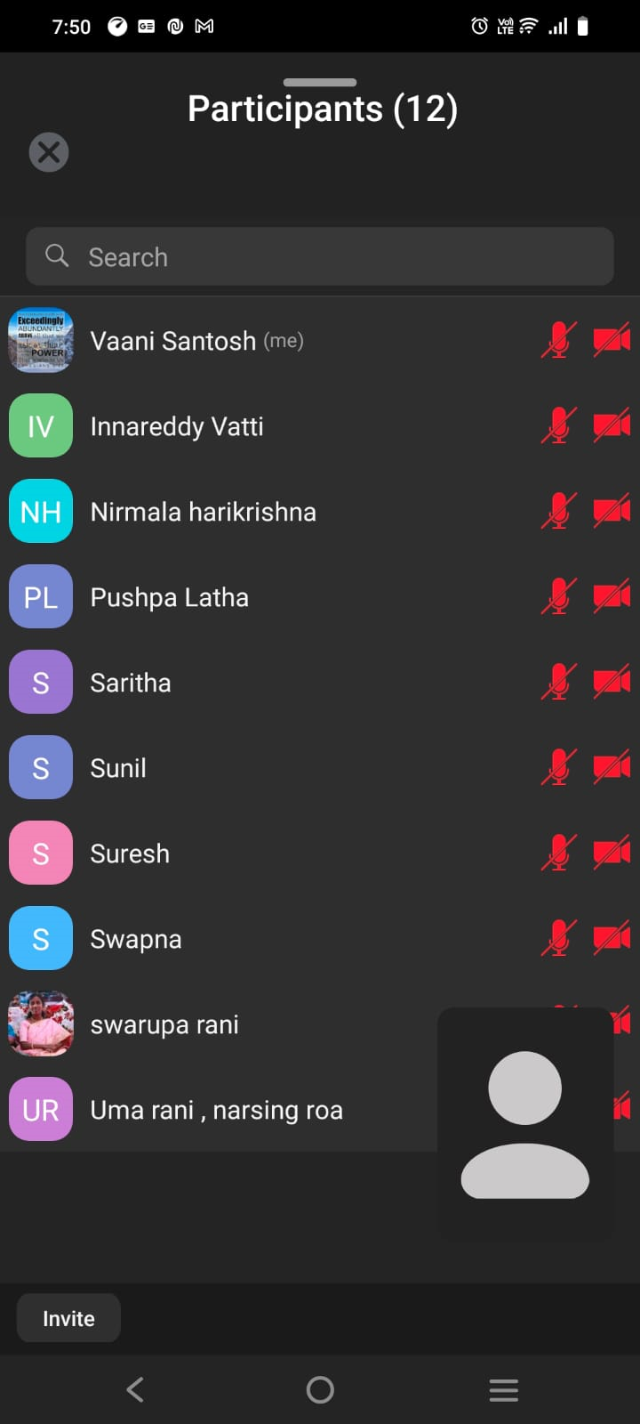
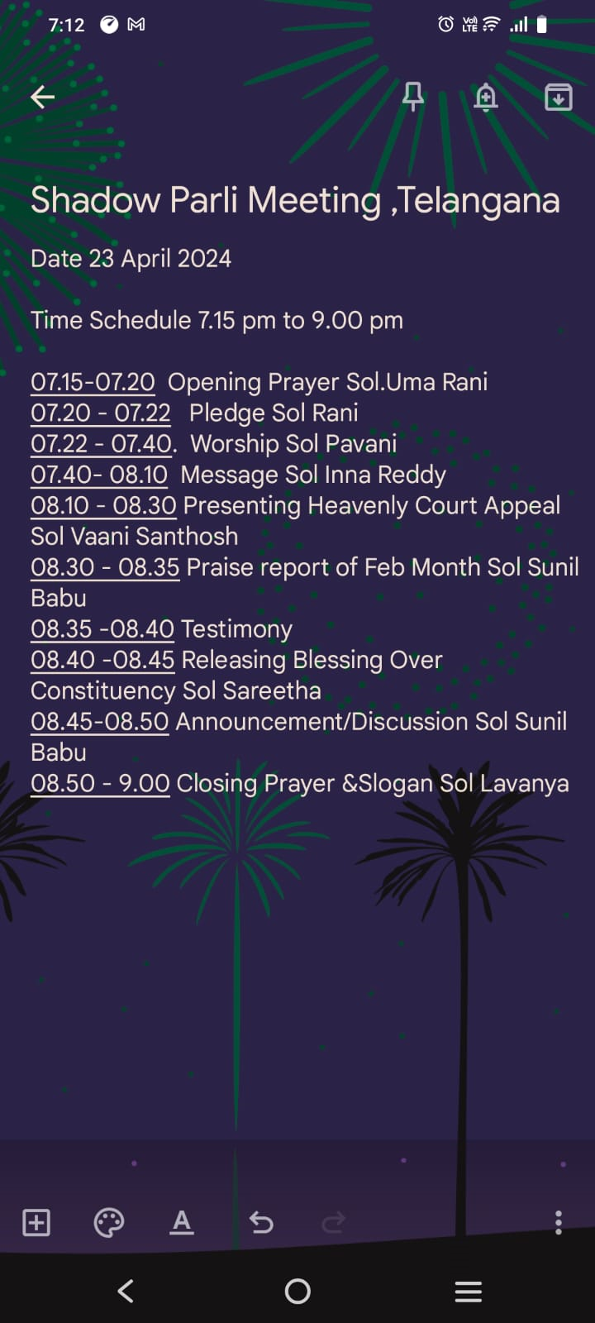
shadow parli meeting
Shadow Parli was conducted on Feb 25,2024 evening 7 pm to 9pm
Around 12 Smps out of 17 smps attended this meeting.
Message them was about the Seven Churches and Seven Angels from the Revelation Book
Heavenly Court Appeal topic is Spiritual Awakening of Telangana State
Revelation during the appeal is Isaiah 14:3

Slide 14

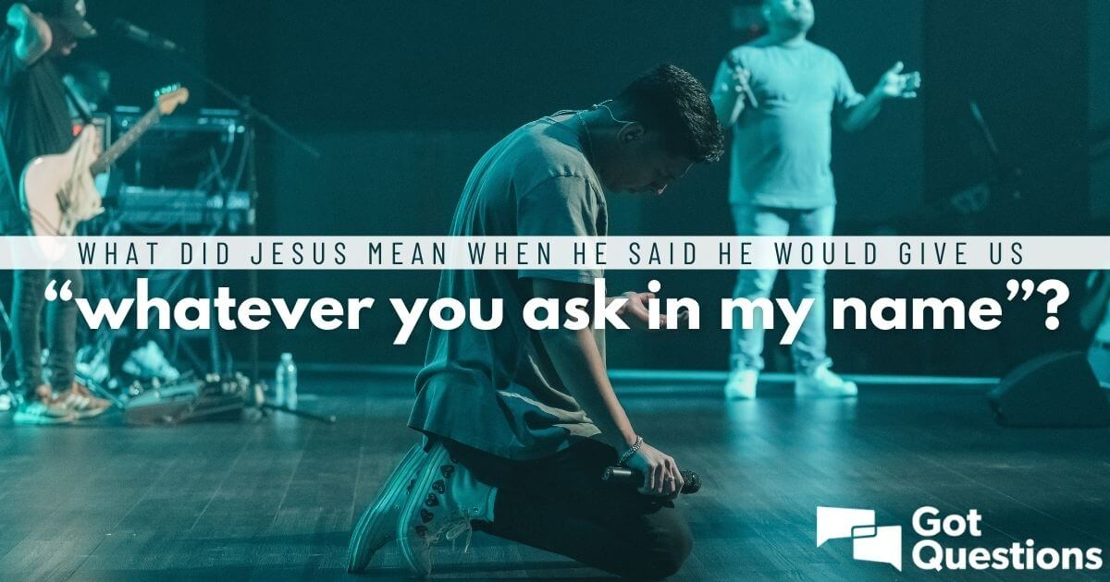
testimony
Sol Pavani Son performed in the inter exams with outstanding marks 562/570 by grace of God.
Sol Nirmala was blessed with new house in Warangal and willing to work for Warangal Constituency.
As soon as Fasting prayer got over on April 27,2024, very next day we heard the news that Karnataka State is willing to send water to Telangana State.
Sol Vaani prayed over a issue by placing a Heavenly Court Appeal with prayer, The Lord answered the Appeal and got an immediate answer in two days.

Slide 15
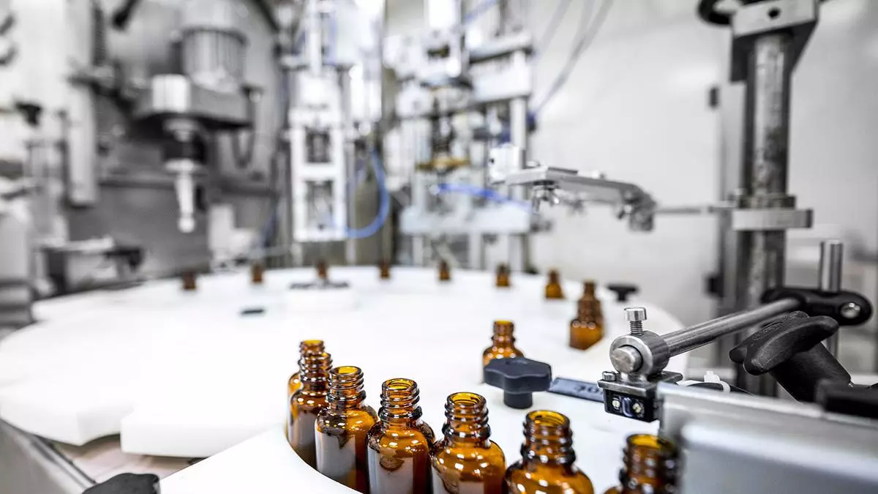
Telangana govt decides to dump Pharma City project Will develop three green field Pharma Village clusters in 1,000-2,000 acres each: Industries Minister Sridhar Babu

Slide 16
Telangana govt decides to dump Pharma City project Will develop three green field Pharma
The government, however, is bringing in an alternative policy to promote Pharma Villates, dispersing the growth of the pharma industry across the State. “We would like to promote the industry across the State. To start with, we will set up 10 pharma villages. Of these, three will be set up in Nalgonda, Vikarabad and Medak districts. “Each of these projects will be taken up in 1,000-2,000 acres. We will talk to the prospective investors and assess their land requirement,” he said, talking to reporters on the sidelines of BioAsia 2024.

Slide 17
Telangana Govt Jobs 2024
Telangana Govt Jobs 2024–25: Telangana Government Jobs 2024 are available on this page. Get latest Telangana govt job 196 Vacancies details on 27.04.2024. Telangana Govt Jobs 2024 recruitment from Telangana Govt Official Website www.telangana.gov.in are also available in our page.
We also post govt jobs in Telangana for 10th, 12th qualification and Telangana government jobs for diploma holders. So aspirants can subscribe to our Telangana Govt jobs notification and get central govt jobs in Telangana 2024.

Slide 18
New proposed upcoming project in telangana
Sitamma Sagar Project
The Sitamma Sagar Project is a proposed reservoir on the Krishna River in Telangana, India. The project is being developed by the National Water Development Agency (NWDA) and is expected to cost ₹10,000 crore. It will have a gross storage capacity of 110 TMC and a live storage capacity of 90 TMC

Slide 19


Telangana election date – may 13,2024

Slide 20
planning of MAY 2024
Children Bible School
BFF
David School of Worship
Family Building School
Fellowship Meeting

Slide 21
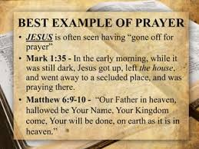
dear father in heaven , let your kingdom come, let your will be done in both Andhra and Telangana state, as it is in heaven.

